Slide 1

Project Alpha
How does Cryptocurrency fit into the established and traditional world of finance?
DISCLAIMER: We are not licensed Financial Advisors*

Slide 2
What is Project Alpha looking to answer?
Are Cryptocurrencies an attractive Asset Class?
What are the financial risks with incorporating Cryptocurrencies into a portfolio?
Can you integrate Cryptocurrencies into a traditional 60/40 financial portfolio?
Is 60/40 feasible in this new environment? What are the optimal weight allocations?
What happens when Crypto keeps growing? When should you rebalance your portfolio? Is there a way to automate this process?

Slide 3
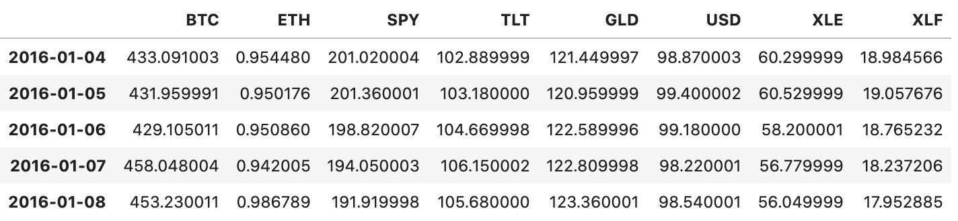
What data did we use and how did we get it?
From Yahoo Finance
BTC - Bitcoin
ETH - Ethereum
SPY - S&P 500
TLT - 20 Year Treasury Bonds
GLD - Gold
USD - United States Dollar
XLE - Energy Sector Fund
XLF - Financial Sector Fund
5 Years of Complete Data Total
Combination of .CSV files and API Data from Yahoo Finance
Pulled Data into dataframe and cleaned it
Integrated it into our financial models
Automated the models to use the dataframe as a benchmark

Slide 4
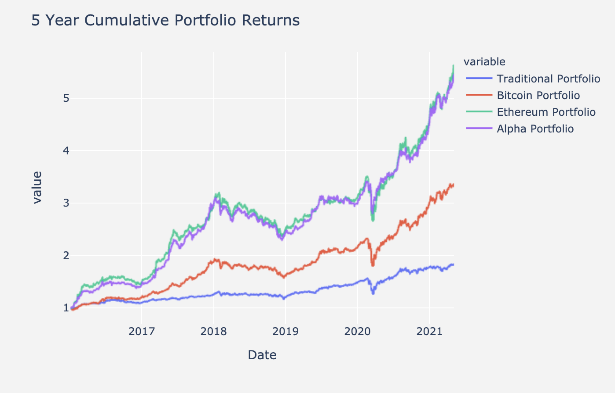
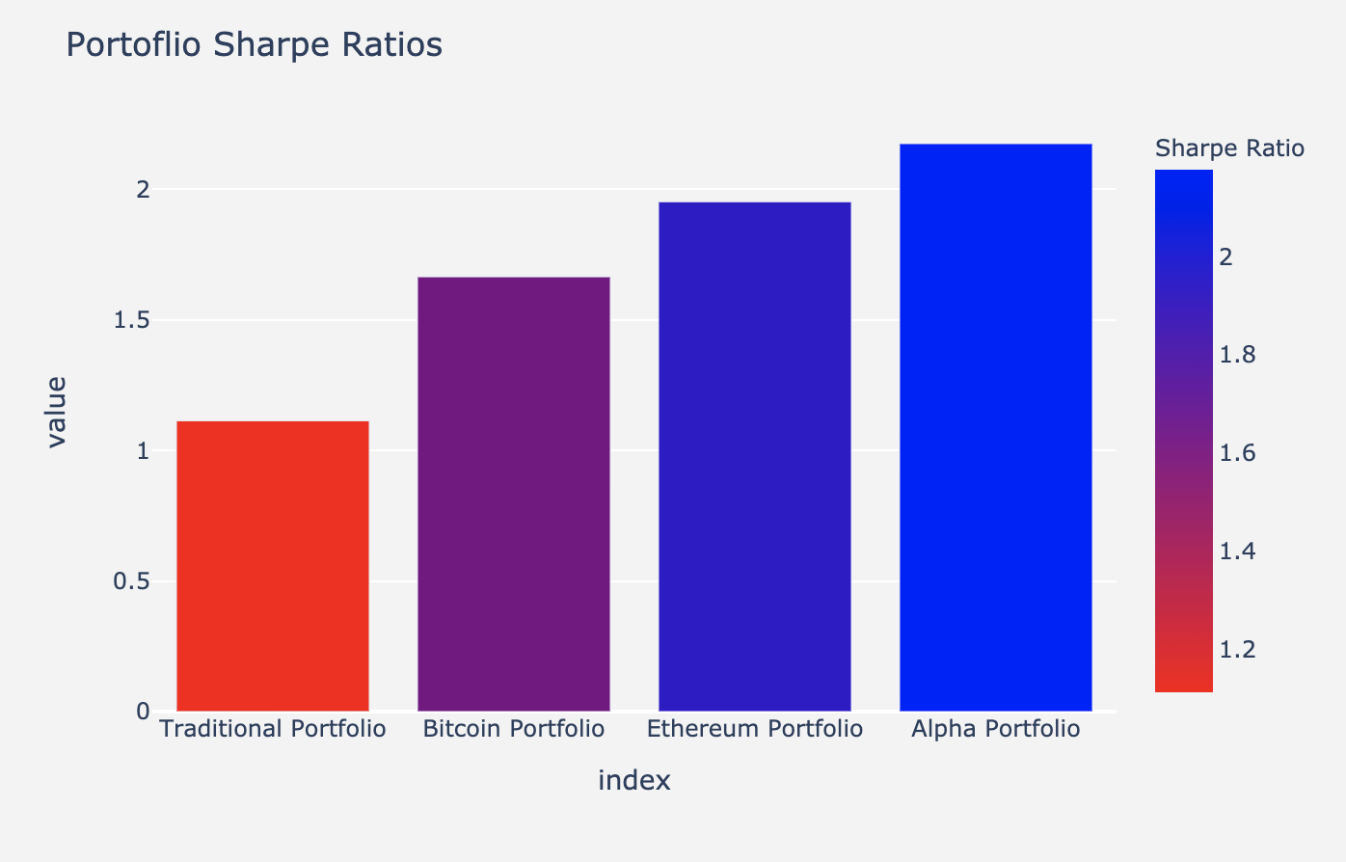
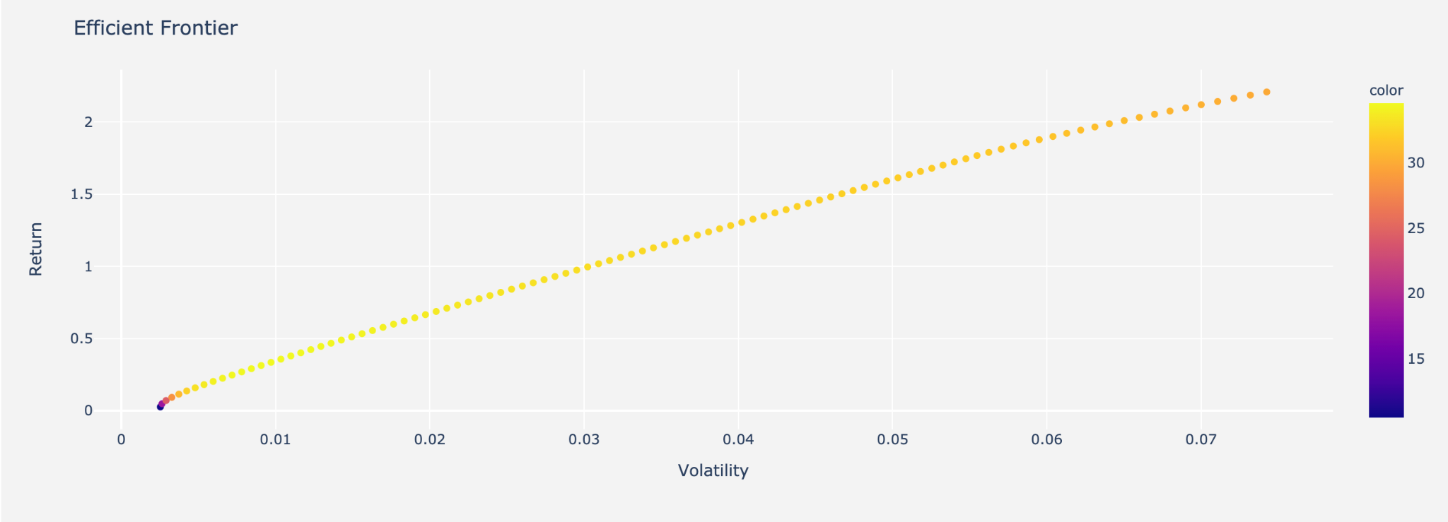
Findings
Here’s what we found . . .

Slide 5

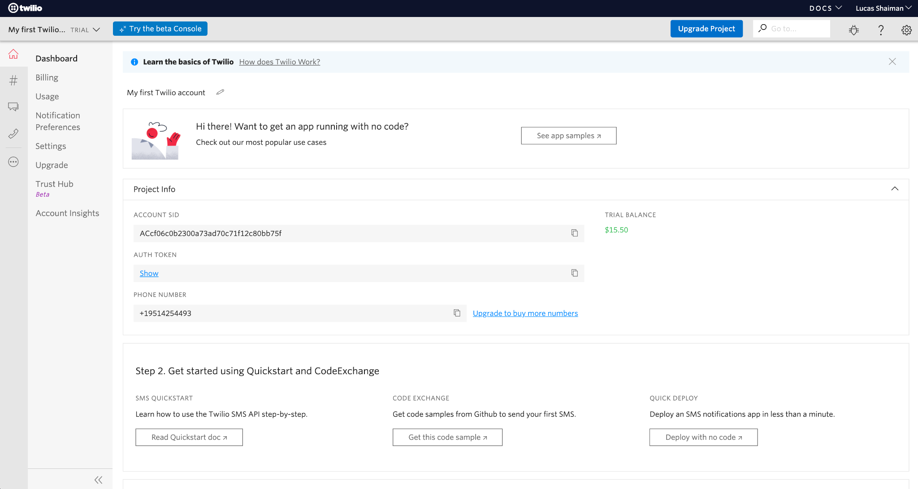


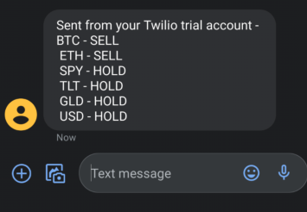
Twilio Demo

Slide 6
Summary
When compared to other asset classes, Cryptocurrencies yield higher Sharpe Ratios
Cryptocurrencies go through extreme volatility but decreases over time
Holding Cryptocurrencies will affect the traditional 60% Equity / 40% bond allocation
Optimal weight allocations will require a lot of oversight and will change frequently with volatility
As Cryptocurrencies continue to grow in equity as well as popularity, automating portfolio rebalancing will be easily achievable by institutional banks to yield the best returns

Slide 7
Resources
Yahoo Finance
Twilio API
Kaggle
Stackoverflow
Dash
Pandas
Pyviz
Plotly
Panel
Numpy
Real Vision - Asset allocation and risk modeling of bitcoin in an institutional portfolio

